Slide 1
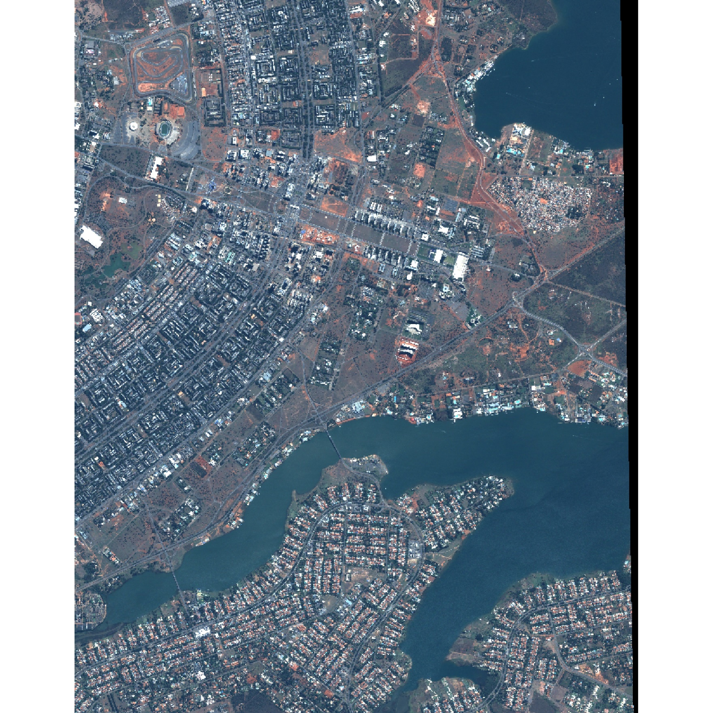
Abrir imagens de Satélite:
install.packages("raster")
library(raster)
library(rgdal)
#ABRIR IMAGEM DE SATÉLITE - SELEÇÃO DE BANDAS MULTIESPECTRAIS ##
r = raster("qb_05jun.tif",band = 3) # Vermelho
g = raster("qb_05jun.tif",band = 2) # Verde
b = raster("qb_05jun.tif",band = 1) # azul
ir= raster("qb_05jun.tif",band = 4) # infravermelho
rgb=brick(b,g,r)
plotRGB(rgb, r=3, g=2, b=1 , stretch='lin')
#composição falsa cor
rgb_fc=brick(b,ir,r)
plotRGB(rgb_fc, r=3, ir=2, b=1 , stretch='lin')

Slide 2
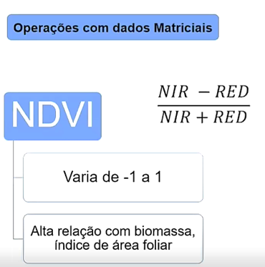
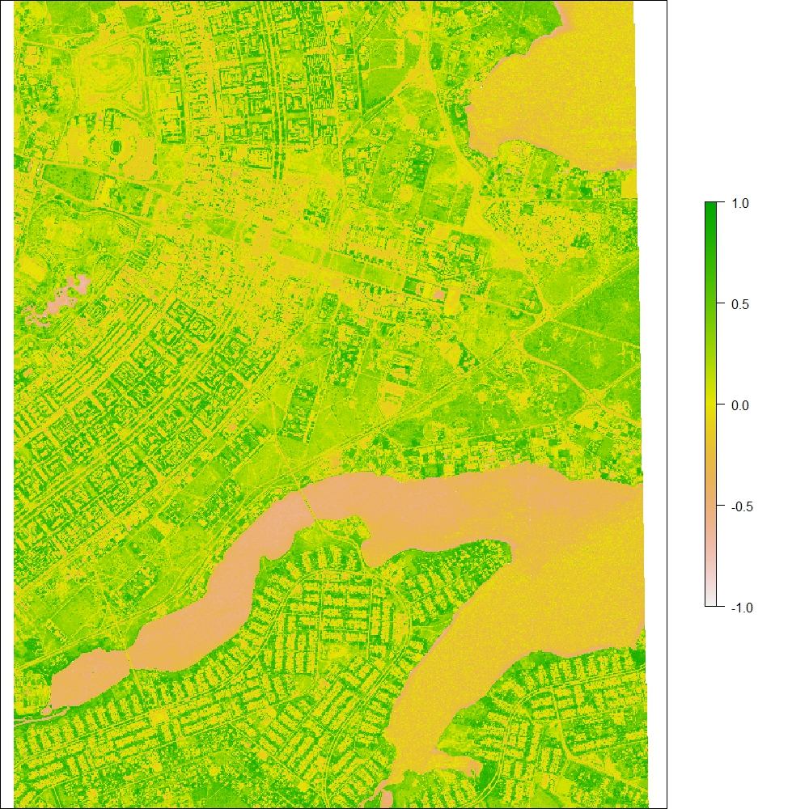
NDVI (Normalized Difference Vegetation Index)
library(raster)
library(rgdal)
#NDVI#
r = raster("qb_05jun.tif",band = 3) # Vermelho
ir= raster("qb_05jun.tif",band = 4) # infravermelho
NDVI = (ir - r)/(ir + r)
plot(NDVI)
Estimar a biomassa
Avaliar a saúde das culturas
Identificar pragas e doenças,
Analisar o crescimento da vegetação ao longo do tempo.
Monitorar a seca e incêndios

Slide 3
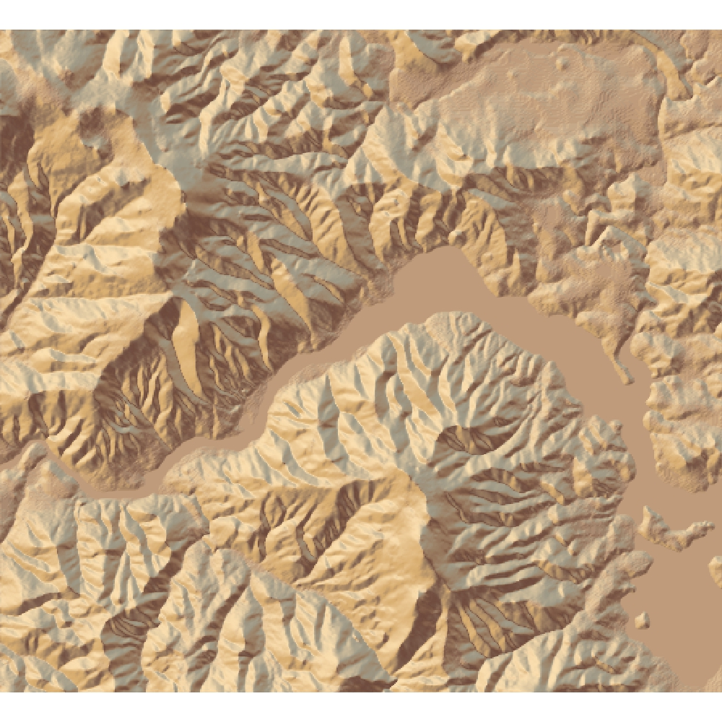
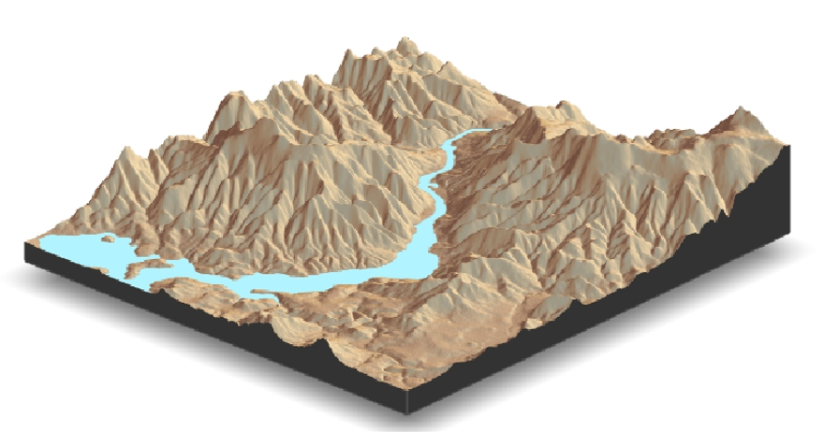
RELEVO 3D
ibrary(rgdal)
library(dplyr)
install.packages("devtools")
devtools::install_github("tylermorganwall/rayshader")
library("rayshader")
loadzip = tempfile()
download.file("https://tylermw.com/data/dem_01.tif.zip",loadzip)
localtif=unzip(loadzip, 'dem_01.tif') %>% raster()
unlink(loadzip)
rast.mat = raster_to_matrix(localtif)
rast.mat %>%
sphere_shade(texture = 'desert') %>%
plot_map()
#visualização 3d
rast.mat %>%
sphere_shade(texture = 'desert') %>%
add_water(detect_water(rast.mat), color='desert')%>%
#add_shadow(ray_shade(rast.mat, zscale = 3),0.5) %>%
#add_shadow(ambient_shade(rast.mat),0)%>%
plot_3d(rast.mat, zscale = 10, fov=0, theta = 135,
zoom = 0.75, phi = 45, windowsize = c(1000,800))
render_snapshot()

Slide 4
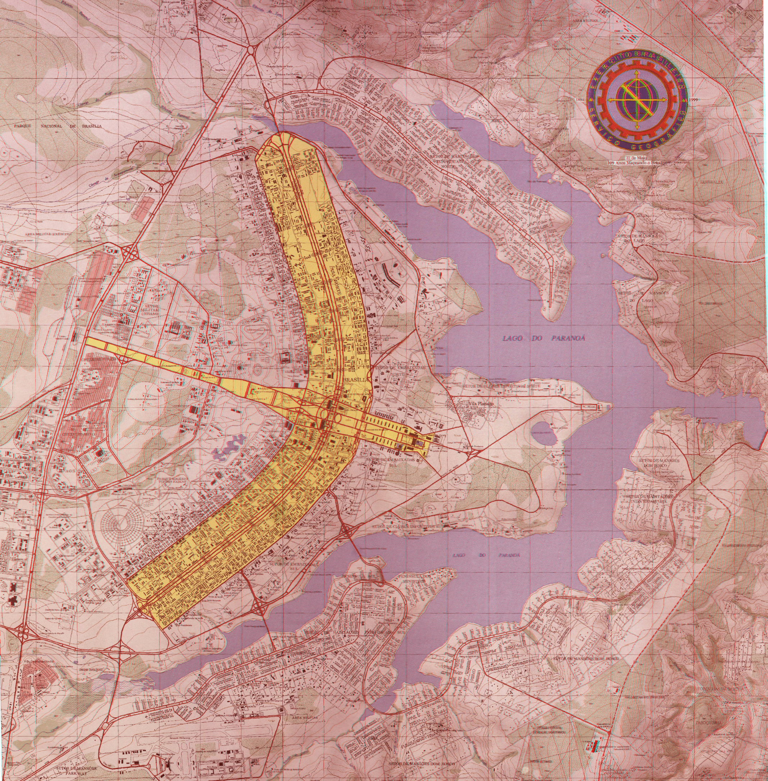
ANAGLIFO
library(raster)
library(rgdal)
r1 = raster("carta_red.jpg",band = 1)
g2 = raster("carta_cyan.jpg",band = 2)
b2 = raster("carta_cyan.jpg",band = 3)
rgb=brick(r1,g2,b2)
plotRGB(rgb, r1=1, g2=2, b2=3 , stretch='lin', maxpixels=1000000)

